Slide 1
OCS Scientific Committee Meeting May 2013
Presenter:
Donna Schroeder
Marine Ecologist
Pacific Region
donna.schroeder@boem.gov
805-389-7805
Contact:
Dave Ball
Pacific Region Historic Preservation Officer
Pacific Region
david.ball@boem.gov
805-389-7593

Slide 2
Proposed FY 2014 Studies – Pacific Region
Page | Discipline | Title | Rank
23 | PO | Expansion of West Coast Oceanographic Modeling Capability | 1
25 | IN (HE/SE) | Potential Impacts of Submarine Power Cables on Crab Harvest | 2
27 | MM | Data Synthesis and High-resolution Predictive Modeling of Marine Bird Spatial Distributions on the Pacific OCS | 3
29 | IN (HE/SE) | Archaeological and Biological Assessment of Submerged Landforms off the Pacific Coast | 4
31 | IM | West Coast Information Transfer Meeting | 5
33 | FE | Predicting and Detecting the Effects of Climate Change and Ocean Acidification Using Long-term Ecological Data | 6
35 | FE | Understanding and Mitigating the Effects of Marine Renewable Energy Technologies on the Coastal and Marine Environment in the Pacific OCS Region | 7
37 | HE | Collecting and Archiving Invertebrates from MARINe Sites for Deposition in the Smithsonian Institution with Local Replicate | 8
39 | HE | Year-round and Diel Patterns in Habitat-use of Seabirds off Oregon | 9
41 | HE | Strategic Resampling of Biodiversity Surveys at MARINe Sites: Completion of the Decadal Assessment | 10
FE = Fates & Effects IN = Interdisciplinary
HE = Habitat & Ecology MM = Marine Mammals & Protected Species
IM = Information Management PO = Physical Oceanography SE = Social & Economic Sciences

Slide 3
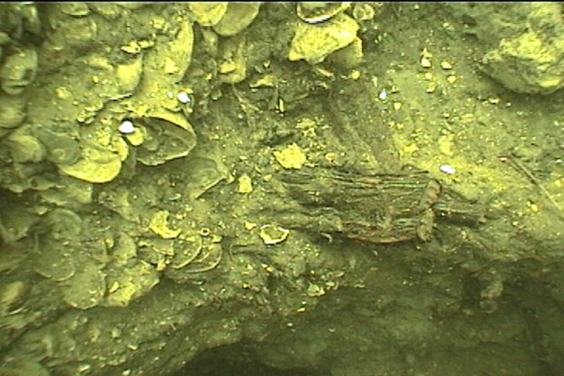
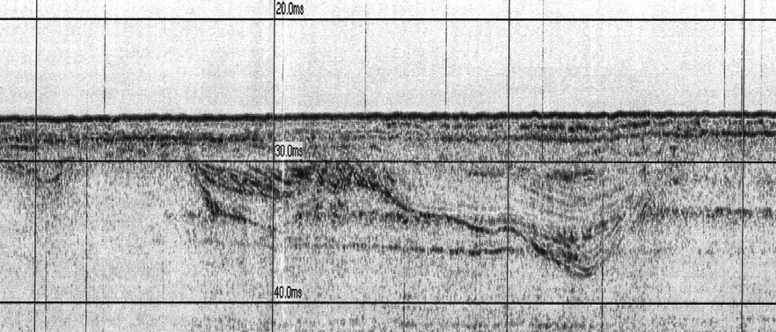
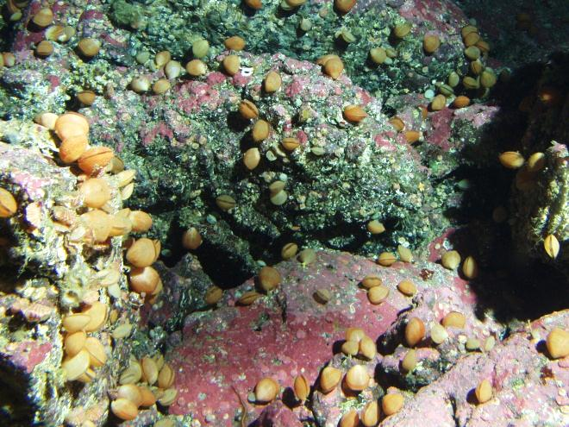
Proposed FY 2014 Study
Supporting Conventional and Renewable Energy
Discipline | Title | Rank
IN (HE/SE) | Archaeological and Biological Assessment of Submerged Landforms off the Pacific Coast | 4
Needed now to assess potential impacts to submerged landforms and associated biological habitat
Insert image of possible habitat associated with submerged landforms.

Slide 4
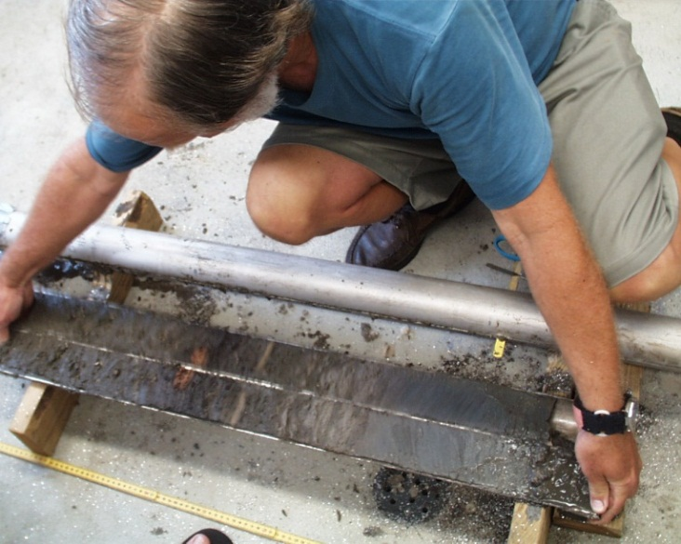
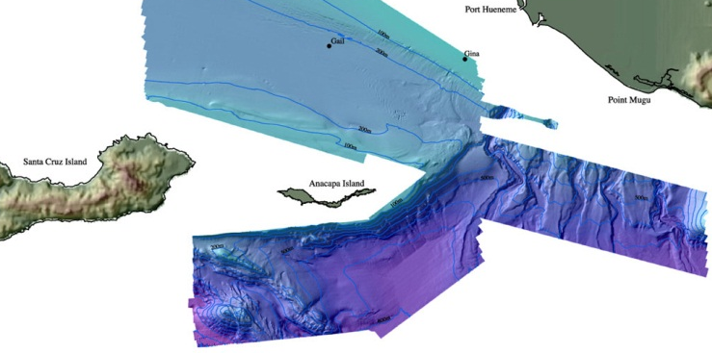
Archaeological and Biological Assessment of Submerged Landforms off the Pacific Coast
BOEM Information Need:
Assess survey guidelines that ID potential submerged landform features
Expand knowledge-base for potential OCS prehistoric sites
Identify sensitive habitats
Relationship to Previous and Ongoing BOEM-Supported Research:
Seafloor and seeps mapping
Archaeological inventories
Benthic habitat studies
Similar efforts in GOM and offshore Rhode Island

Slide 5
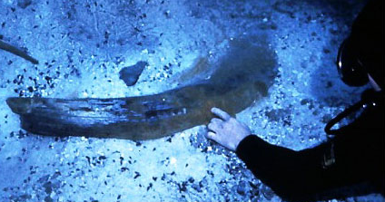
Archaeological and Biological Assessment of Submerged Landforms off the Pacific Coast
BOEM Objectives:
Conduct field investigations of areas that have been identified as having a high potential to be associated with paleocultural landforms
Field test a geospatial model that will aid in the identification and classification of potential paleocultural landforms from existing remote sensing data and seafloor maps in areas along the Pacific Coast
Identify paleolandform features that may indicate sensitive habitat areas

Slide 6
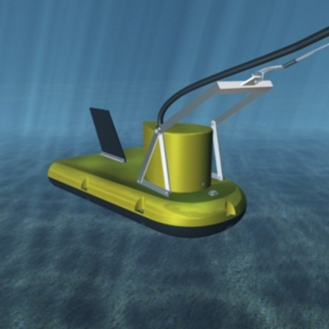
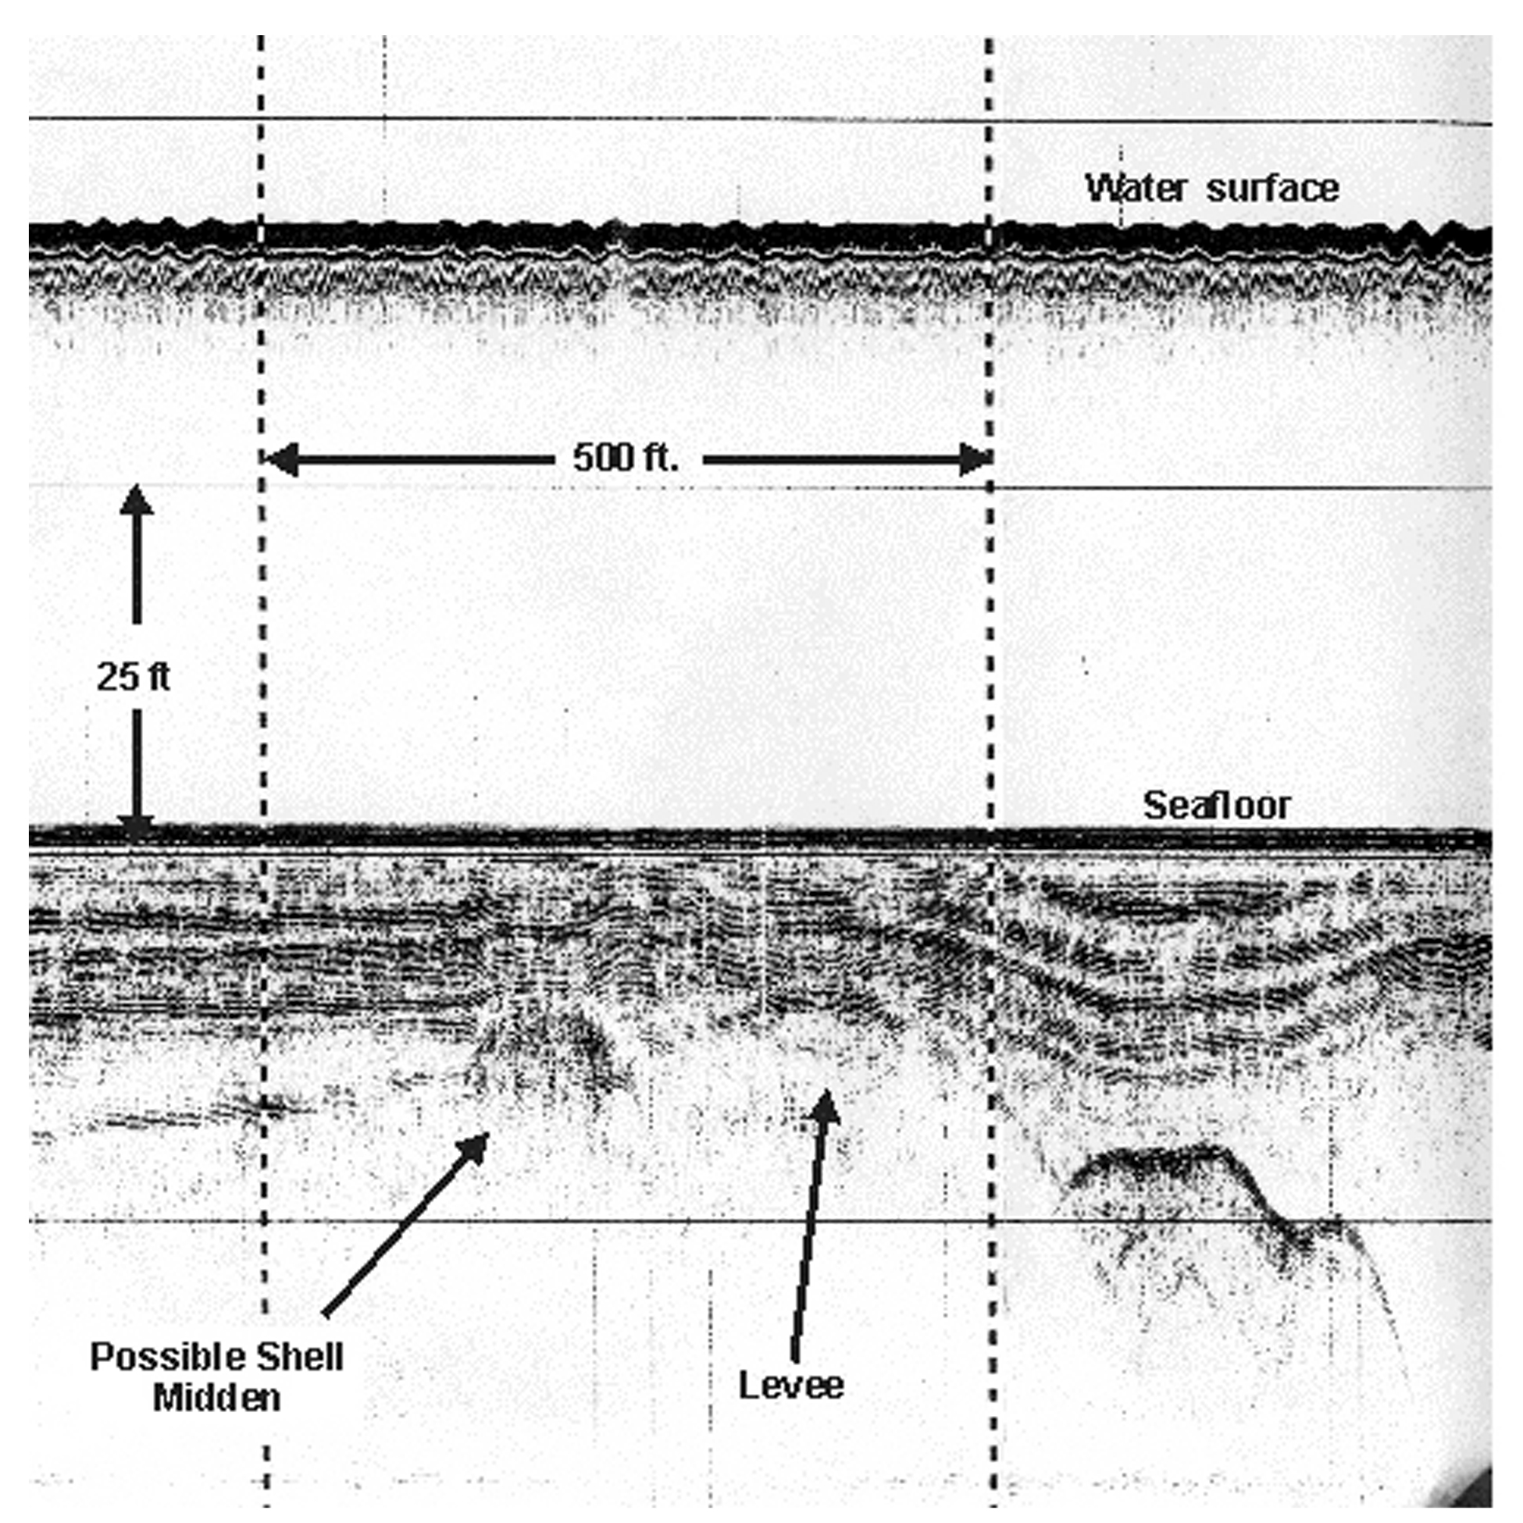
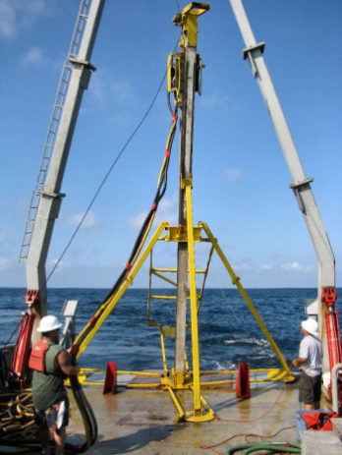
Archaeological and Biological Assessment of Submerged Landforms off the Pacific Coast
Study Methods:
Evaluate existing remote sensing data and review current theories on sea level rise during the Last Glacial Maximum (LGM) to identify high probability areas for further testing.
Conduct fine-scale survey and ground-truth at least four submerged landform features.
Analyze new data for possible indicators of prehistoric human activity and biological resources associated with paleolandforms.
Develop and refine a model that can be used to interpret remote sensing data and seafloor maps in other areas along the Pacific Coast.

